Slide 1

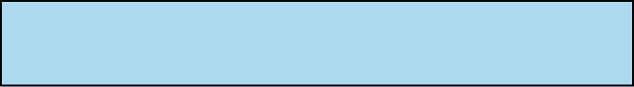


TEAM_D
ALL-IN LESSON
MIDTERM PROGRESS
Team D
이승환, 이채연, 박문희, 정재윤
2024.10.25

Slide 2


ALL-IN LESSON
CONTENTS
1
Objective & Goals
2
Role Distribution
3
UI/UX Design with Demo
( Front-end )
4
Implementation Progress
( Back-end )
5
Challenges & Limitations
6
Scheduled Plans

Slide 3



ALL-IN LESSON
01.
Objective
& Goals
(RECAP)
Why?
- use multiple tools for single purpose of tutoring
- no integrated management tool for students or parents
What?
- all-in-one web application designed for each roles
(tutors, students, parents)
How?
Tutor - Integrated calendar, multiple students' report,
managing diverse curricula for each
Student - Integrated calendar, personal achievements,
assignments/supplements, reward system,
progress report
Parent - Quick-look calendar, tuition payment dates,
student's report

Slide 4







ALL-IN LESSON
[ Front-end ]
02.
Role
Distribution
Figma design completion
Figma design completion
Initial Environment Setting
Initial Environment Setting
박문희
정재윤
이승환
이채연
Initial Environment Setting
Figma design completion
Database Schema
Database Schema
Login API - Naver/Custom
Login API - Google/Kakao
[ Back-end ]

Slide 5

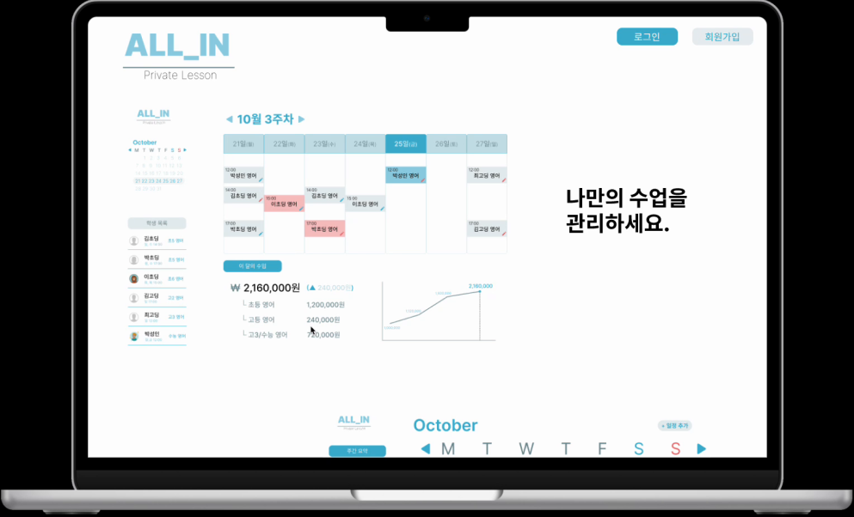
ALL-IN LESSON
03. UI/UX with Demo
( Front-end )
Tutor Version

Slide 6
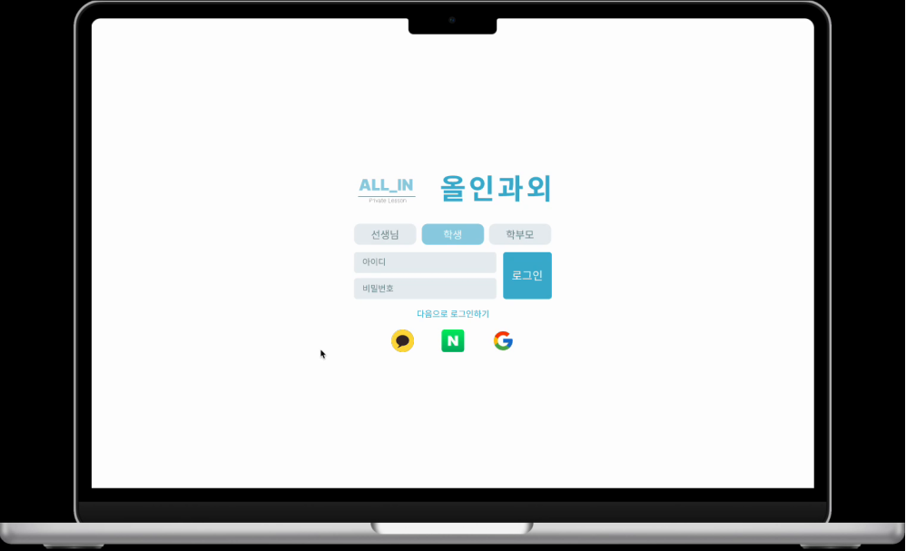
ALL-IN LESSON
03. UI/UX with Demo
( Front-end )
Student Version

Slide 7
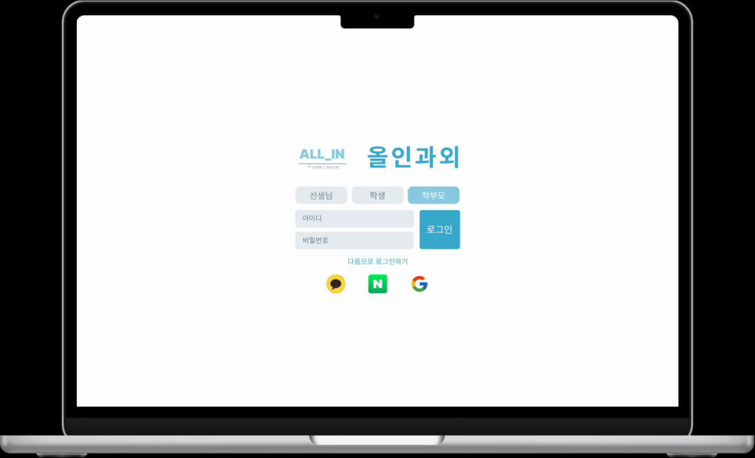
ALL-IN LESSON
03. UI/UX with Demo
( Front-end )
Parent Version

Slide 8
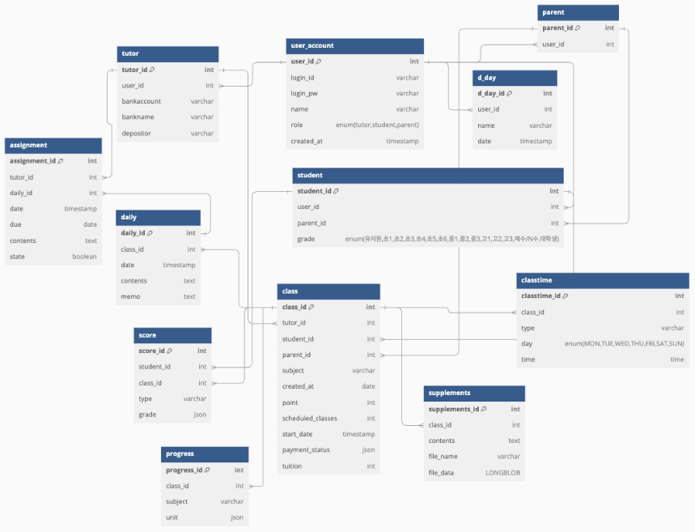
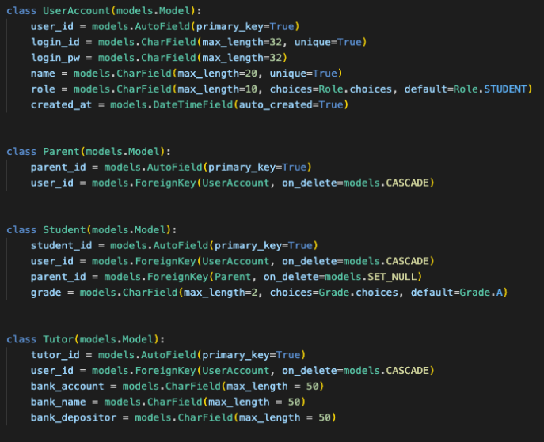
ALL-IN LESSON
04. Implementation Progress
( Back-end )

Slide 9



ALL-IN LESSON
05. Challenges & Limitations
| Technological Issues |
| Limitations |
Four beginners →
additional studies
(docker, frontend)
X parent responses →
imagine needs,
possibly add features
X clear tech stack (FE) →
fixed with React
Not used to Figma →
took longer time than planned at first
when released,
may consider
other stacks
Conflicts with design →
one supervisor
Too light tech stacks →

Slide 10

ALL-IN LESSON
06. Scheduled Plans
 | Week 9 | Week 10 | Week 11 | Week 12 | Week 13 | Week 14
Backend | DB Schema
 | Login API
Frontend | Figma
 | Implementation
Integration |  |  | FE/BE Integration
Beta Version |  |  |  |  | Beta Testing
 |  |  |  |  | Debugging

Slide 11
ALL-IN LESSON
THANK YOU.
Team_D

